Slide 1
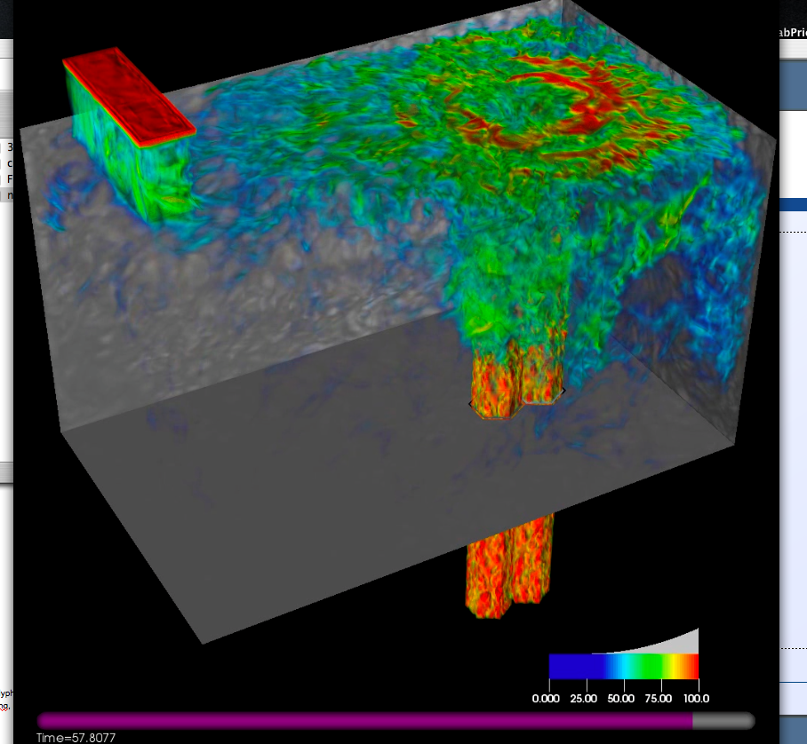
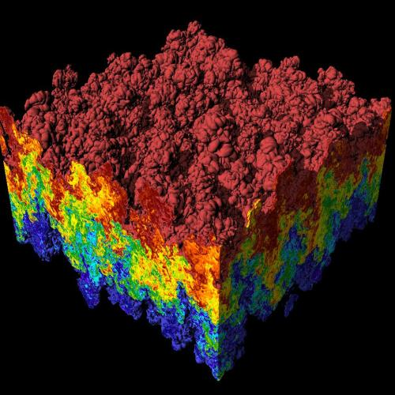
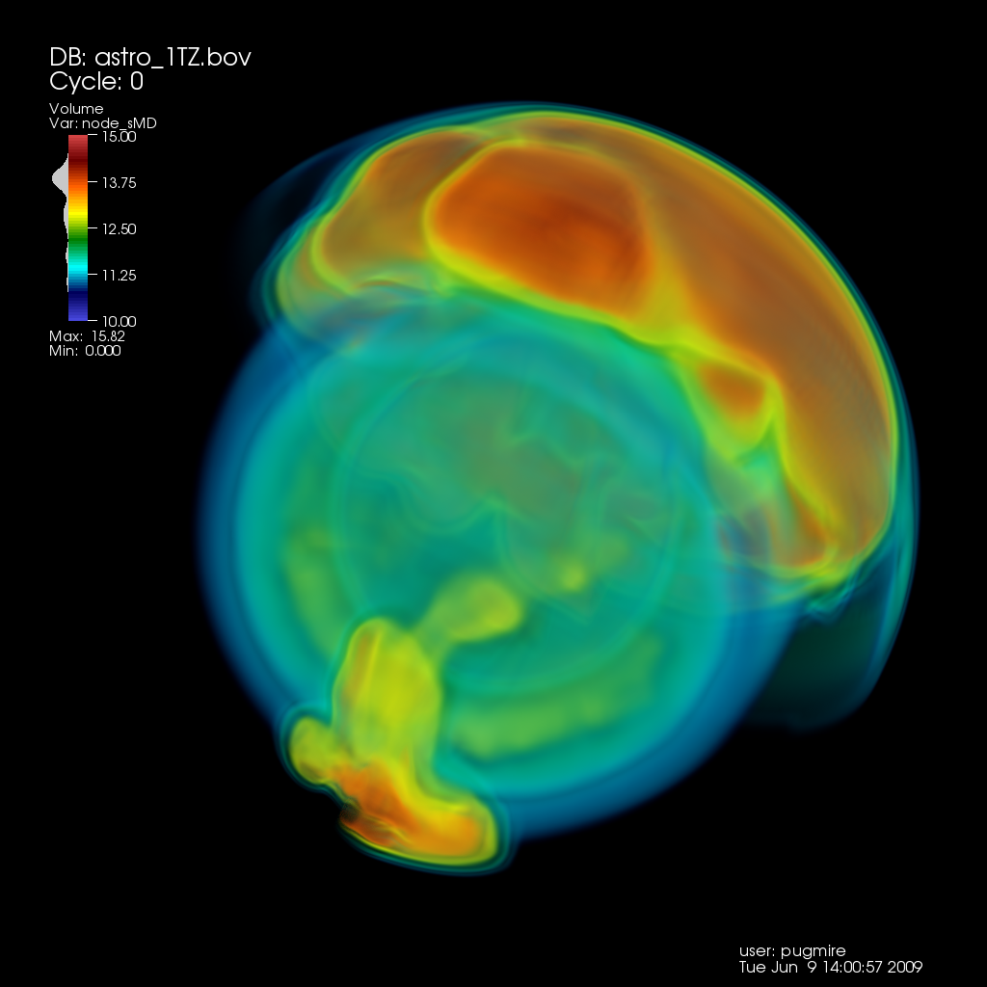
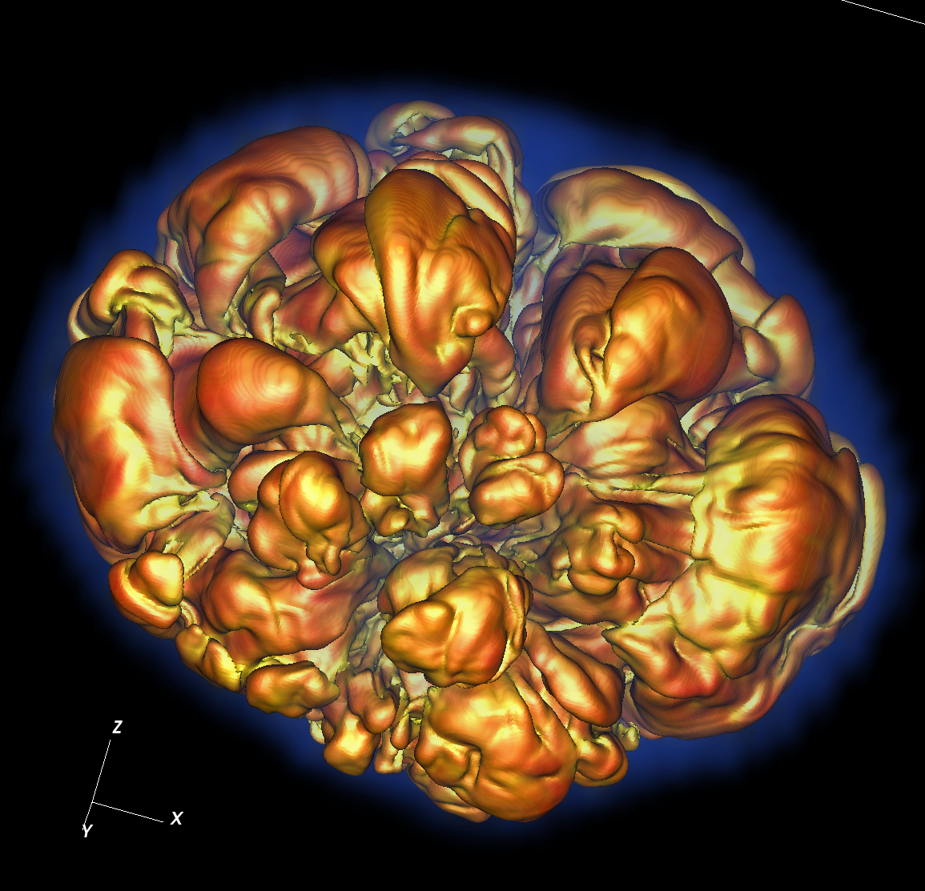
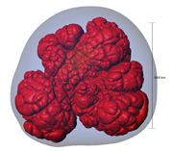
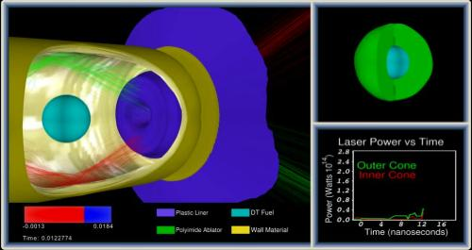
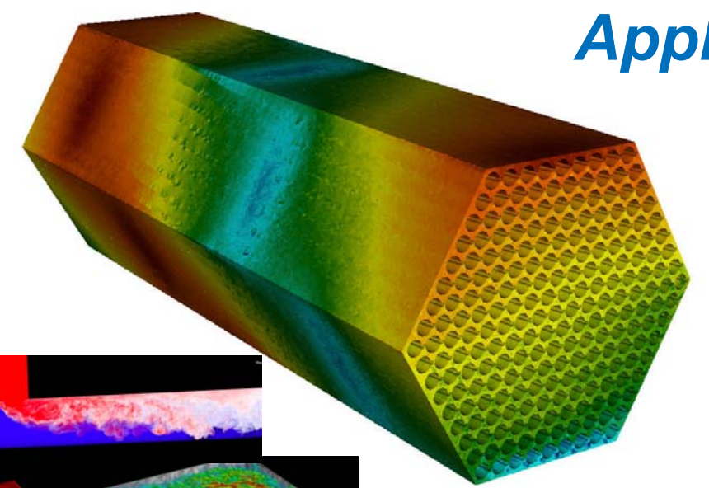
CIS 441/541: Intro to Computer Graphics Lecture 9: More OpenGL!
February 7, 2019
Hank Childs, University of Oregon

Slide 2
Office Hours: Week 5
Monday: 1-2 (Roscoe)
Tuesday: 1-2 (Roscoe)
Wednesday: 1-3 (Roscoe)
Thursday: 1130-1230 (Hank)
Friday: 1130-1230 (Roscoe)

Slide 3
Timeline (1/2)
1F: assigned Feb 7th (Feb 1), due Feb 19th
→ not as tough as 1E
2A: posted now, due Feb 21st
→ you need to work on both 1F and 2A during Week 6 (Feb 11-15)
2B: posted now, due Feb 27th
YouTube lectures for Feb 12th and 14th

Slide 4
Timeline (2/2)
Sun | Mon | Tues | Weds | Thurs | Fri | Sat
Feb 3 | Feb 4 | Feb 5 Lec 8 | Feb 6 1E due | Feb 7 Begin 1F, begin 2A | Feb 8 | Feb 9
Feb 10 | Feb 11 | YouTube | Feb 13 | YouTube?? | Feb 15 | Feb 16
Feb 17 | Feb 18 | Feb 19 1F due | Feb 20 | Feb 21 2A due, begin 2B | Feb 22 | Feb 23

Slide 5
Comparing to previous terms (1/2)
Way ahead on lecture
If I complete today’s lecture, we will be 1.5 lectures ahead of the pace from previous term
Why?:
YouTube videos saving on material repeat
Bad materials in previous terms, and then have to waste class time fixing things
May only need 1 YouTube lecture from Japan

Slide 6
Comparing to previous terms (2/2)
A little behind on project pace
The W19 plan only works if you pursue *both* 1F and 2A during Week 6!
Project | Due date (F16) | Due date (W19)
1E | Monday of Week 5 | Weds of Week 5
1F | Monday of Week 6 | Tuesday of Week 7
2A | Monday of Week 7 | Thursday of Week 7
2B | Monday of Week 8 | Wednesday of Week 8

Slide 7
Midterm
Date still not set
Considering different plan: 25 & 5

Slide 8
First OpenGL programs
Remember: none of these programs have windowing or events
They contain just the code to put primitives on the screen, with lighting and colors.

Slide 9
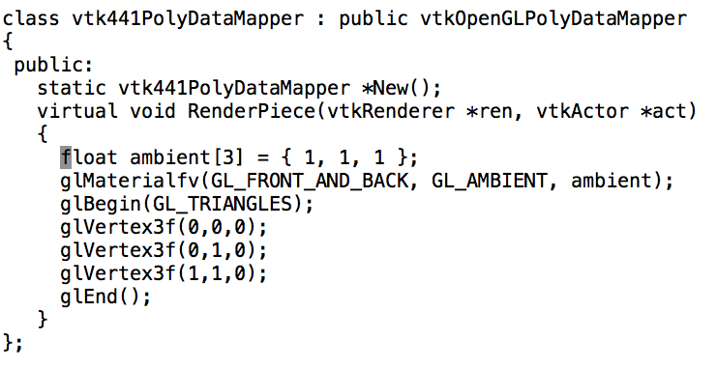

First OpenGL programs

Slide 10
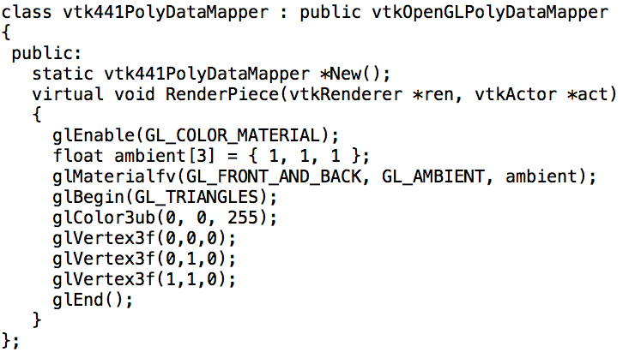
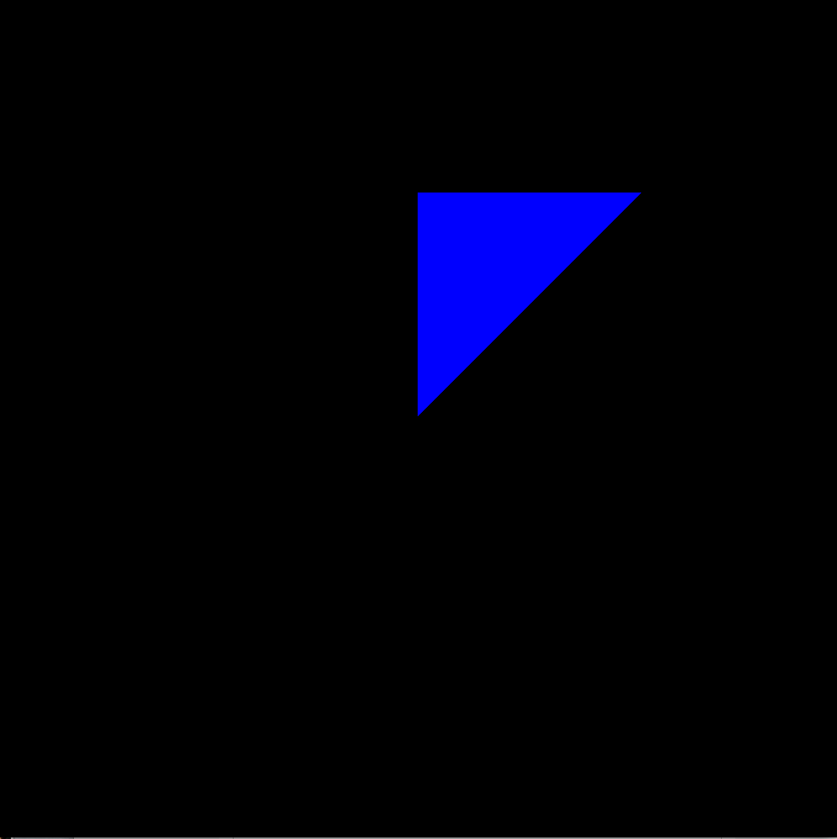
First OpenGL programs

Slide 11
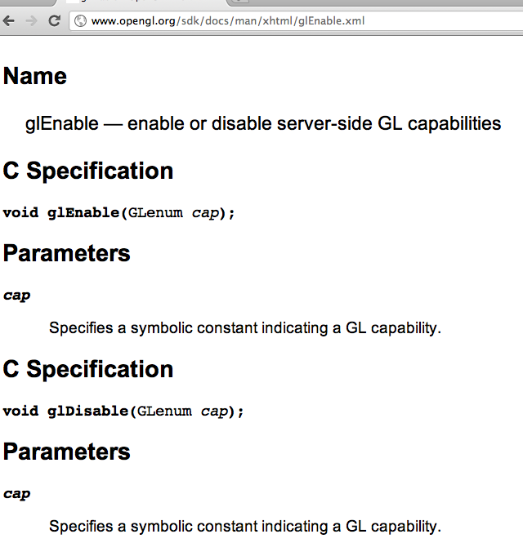
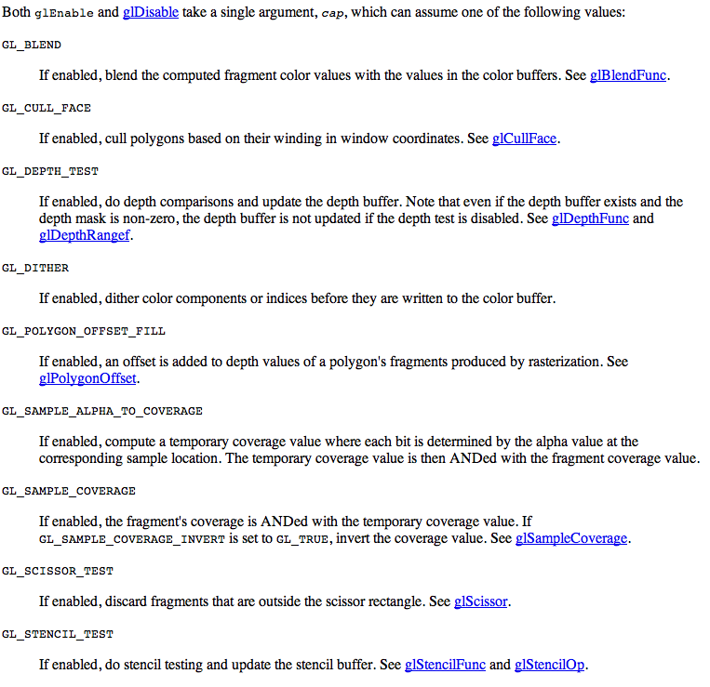
glEnable/glDisable: important functions

Slide 12
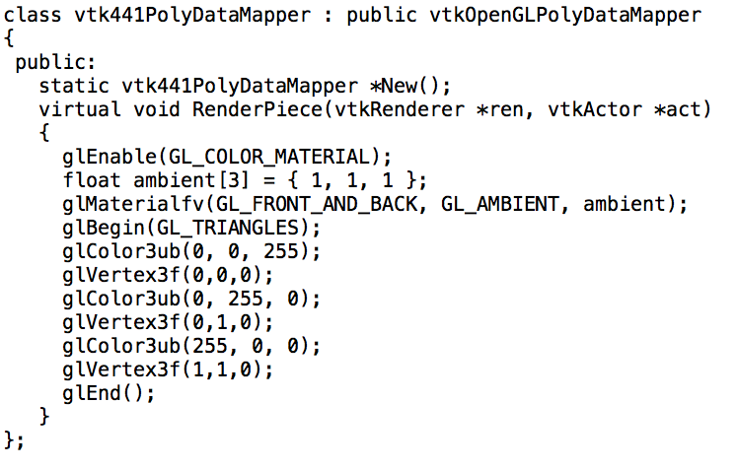
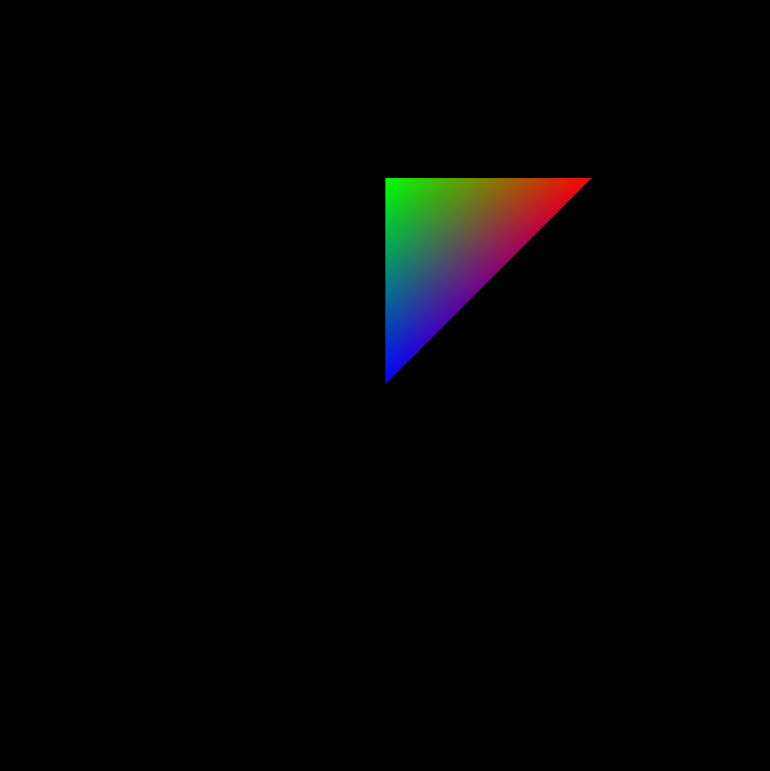
First OpenGL programs

Slide 13
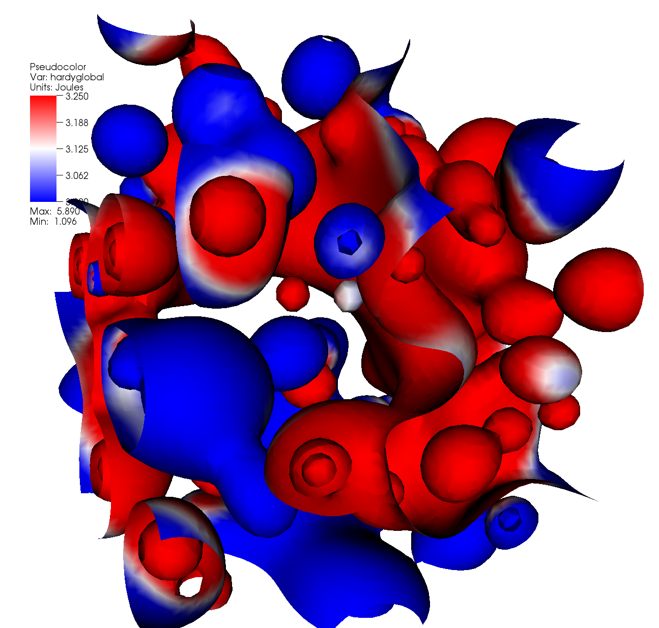
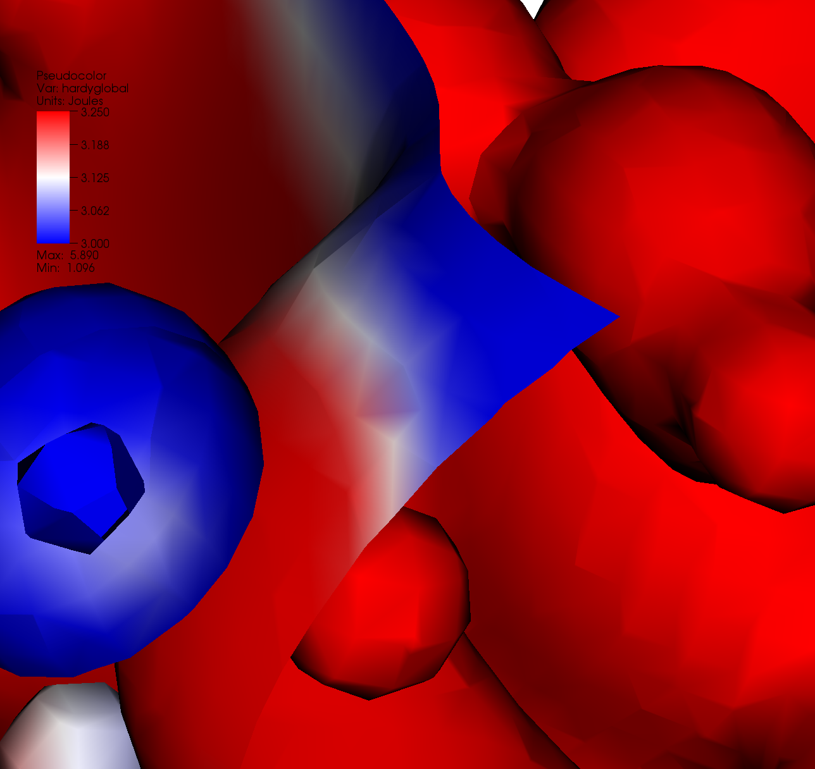
Visualization use case
Why is there purple in this picture?

Slide 14
First OpenGL programs

Slide 15
Textures
“Textures” are a mechanism for adding “texture” to surfaces.
Think of texture of a cloth being applied to a surface
Typically used in 2D form
We will start with a 1D form, and work our way up to 2D later.

Slide 16
1D textures: basic idea
Store color map on GPU as a texture
An array of colors
Old color interpolation of fragment on a scanline:
For (int j = 0 ; j < 3 ; j++)
RGB[j] = leftRGB[j] + proportion*(rightRGB[j]-leftRGB[j])
New color interpolation of fragment on a scanline:
textureVal = leftTextureVal
+ proportion*(rightTextureVal-leftTextureVal)
RGB ← textureLookup[textureVal]
Notes:
Difference between textureVal and RGB？

Slide 17
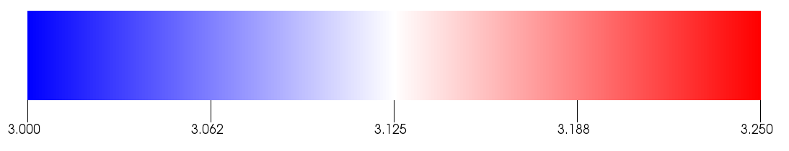
Example
T=0
T=1
sdf
Triangle with vertices with scalar values 2.9, 3.3, and 3.1.
T for 2.9 = (2.9-3.0)/(3.25-3) = -0.4
T for 3.1 = (3.1-3.0)/(3.25-3) = 0.4
T for 3.3 = (3.3-3.0)/(3.25-3) = 1.2
Fragment colors come from interpolating texture coordinates and applying texture

Slide 18
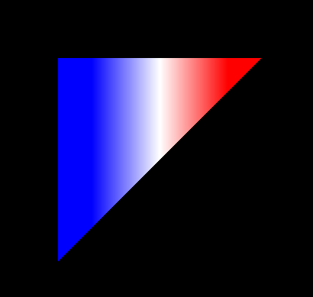
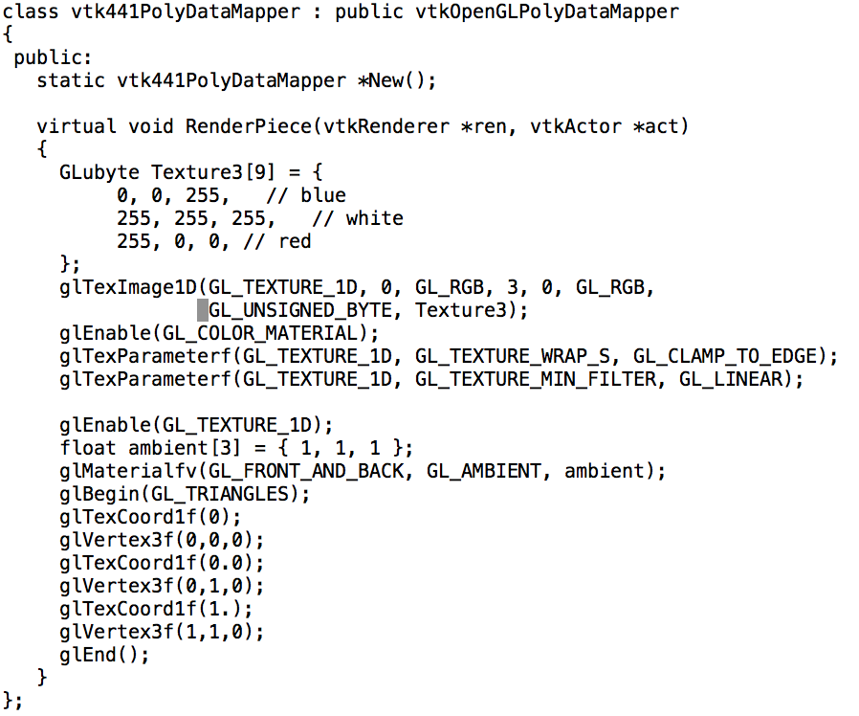
First OpenGL Texture Program
(advanced texture features & 2D textures on Weds)

Slide 19
Project 2A (START RECORDING)

Slide 20
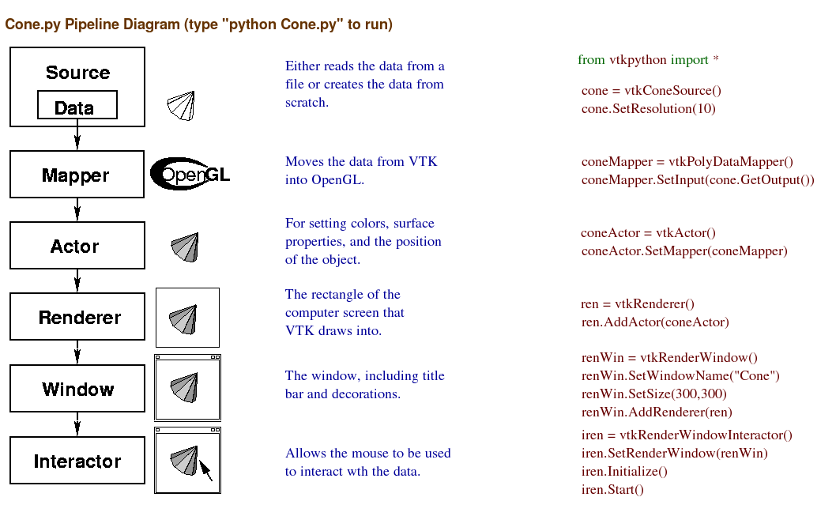
We will replace these and write our own GL calls.
We will re-use these.

Slide 21
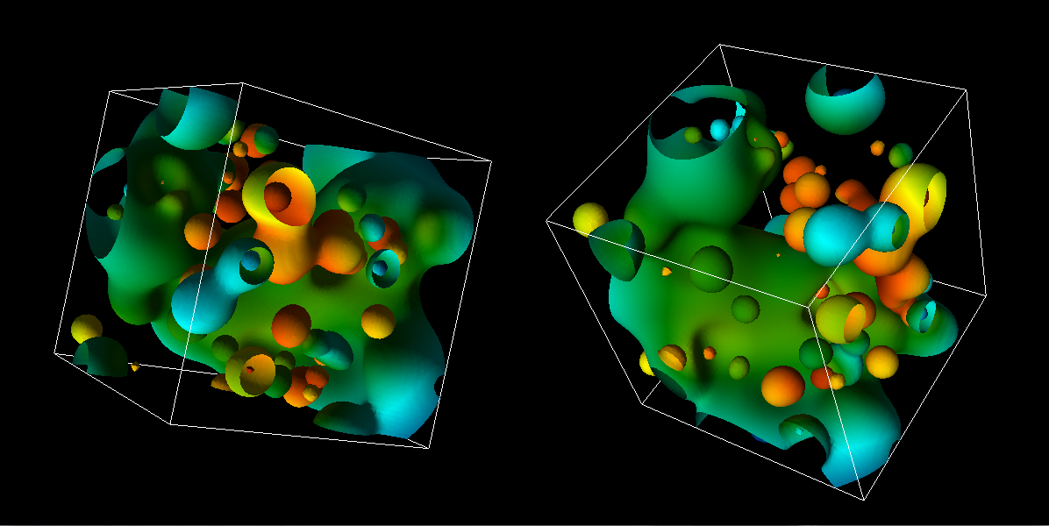
Project #2A (8%), Due Feb. 21st
Goal: OpenGL program that does regular colors and textures
New VTK-based project2A.cxx
New CMakeLists.txt (but same as old ones)

Slide 22
Hints
I recommend you “walk before you run” & “take small bites”. OpenGL can be very punishing. Get a picture up and then improve on it. Make sure you know how to retreat to your previously working version at every step.
OpenGL “state thrashing” is common and tricky to debug.
Get one window working perfectly.
Then make the second one work perfectly.
Then try to get them to work together.
Things often go wrong, when one program leaves the OpenGL state in a way that doesn’t suit another renderer.

Slide 23
Hints
MAKE MANY BACKUPS OF YOUR PROGRAM
USE VTK 6
If you are having issues on your laptop with a GL program, then use Room 100
(There’s only 2 of these projects)

Slide 24
How to do colors (traditional)…
The Triangle class now has a “fieldValue” data member, which ranges between 0 and 1.
You will map this to a color using the GetColorMap function.
GetColorMap returns 256 colors.
Mappings
A fieldValue value of 0 should be mapped to the first color
A fieldValue value of 1 should be mapped to the 255th color.
Each fieldValue in between should be mapped to the closest color of the 256, but interpolation of colors is not required.

Slide 25
How to do colors (texture)…
Same idea, but use texture infrastructure
(easier)

Slide 26
END RECORDING

Slide 27
More on Textures

Slide 28
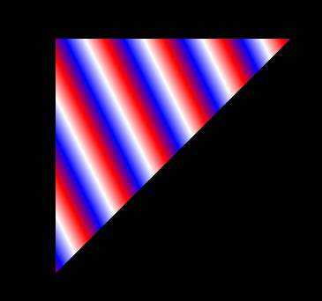
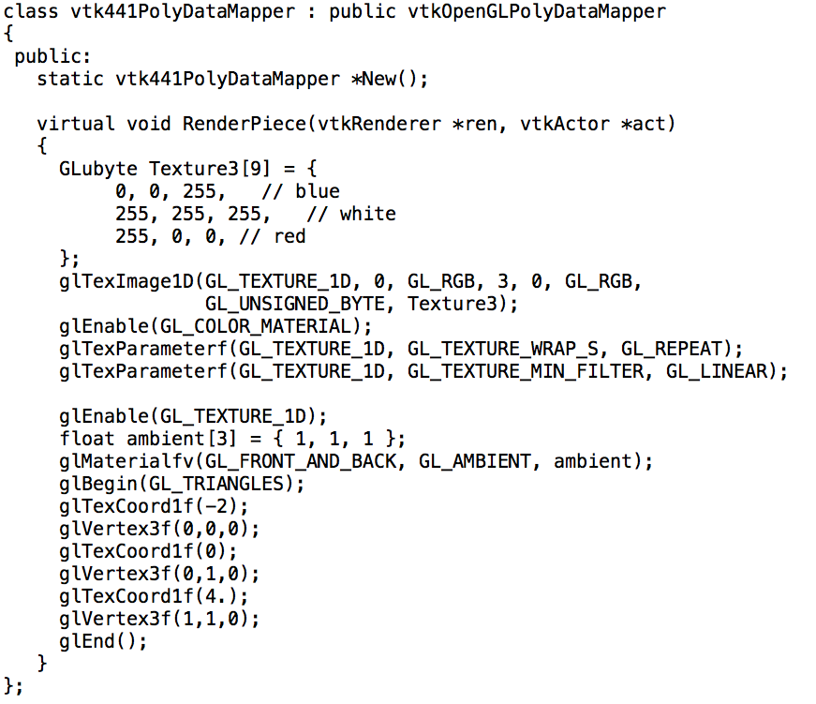
Textures with GL_REPEAT

Slide 29
1D, 2D, 3D textures
2D textures most common
1D textures: color maps (e.g., what we just did)
3D textures: “volume rendering”
Use combination of opacity
and color (i.e., RGBA)

Slide 30
2D Textures
Pre-rendered images painted onto geometry
glTexImage1D → glTexImage2D
GL_TEXTURE_WRAP_S → GL_TEXTURE_WRAP_S + GL_TEXTURE_WRAP_T
glTexCoord1f → glTexCoord2f

Slide 31

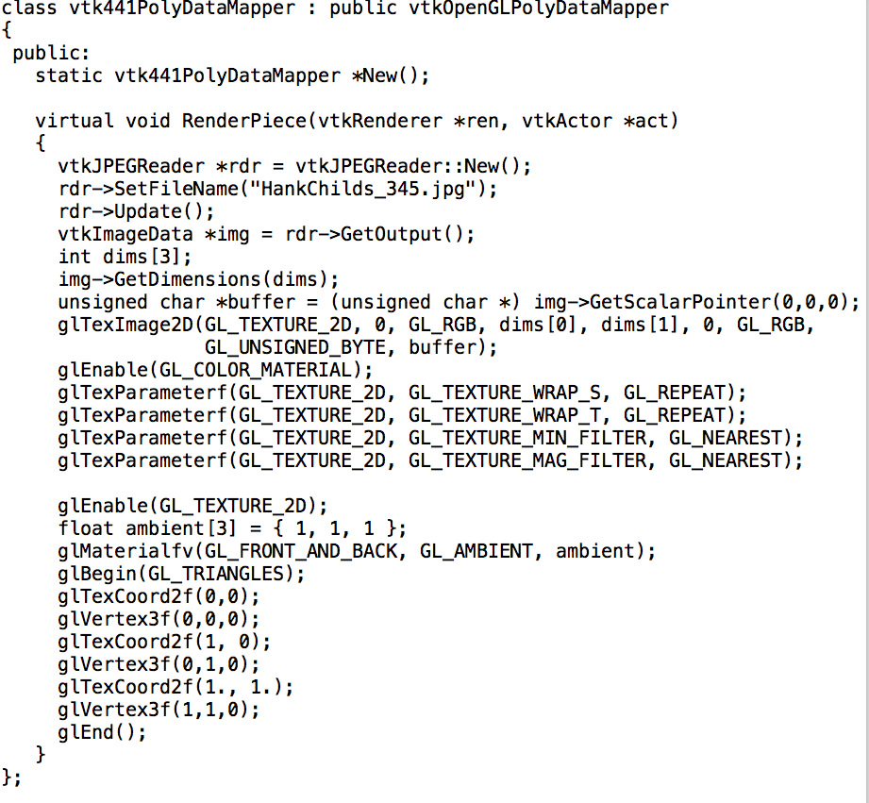
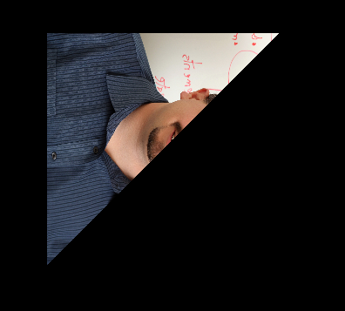
2D Texture Program
What do we expect the output to be?

Slide 32
GL_TEXTURE_MIN_FILTER / GL_TEXTURE_MAG_FILTER
Minifying: texture bigger than triangle.
How to map multiple texture elements onto a pixel?
GL_NEAREST: pick closest texture
GL_LINEAR: average neighboring textures
Magnifying (GL_TEXTURE_MAG_FILTER): triangle bigger than texture
How to map single texture element onto multiple pixels?
GL_NEAREST: no interpolation
GL_LINEAR: interpolate with neighboring textures

Slide 33
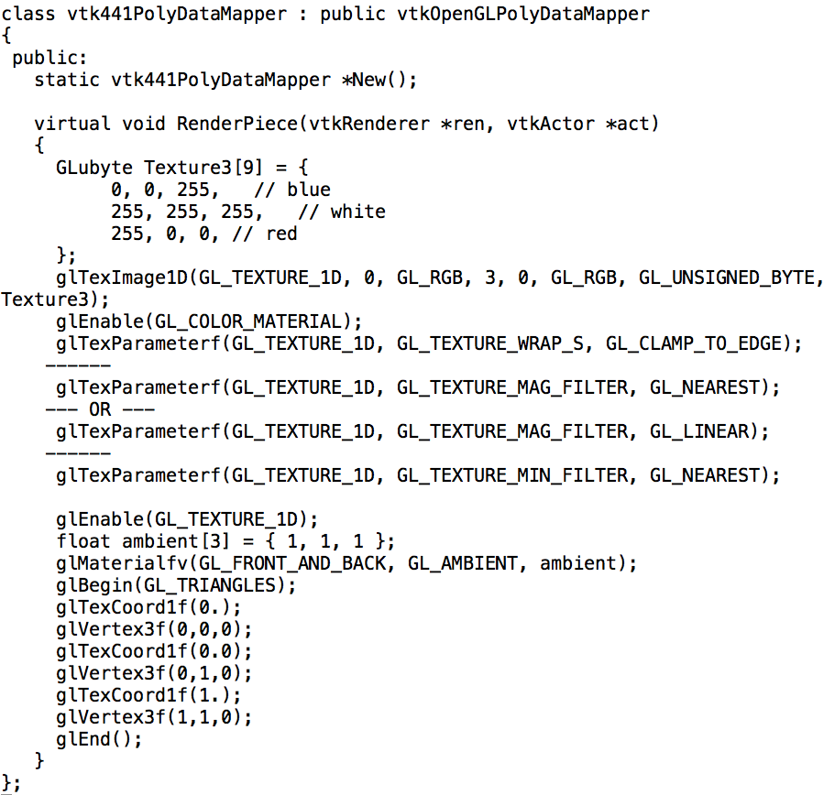
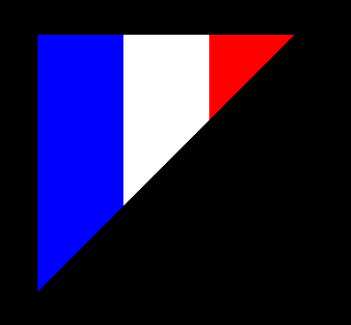
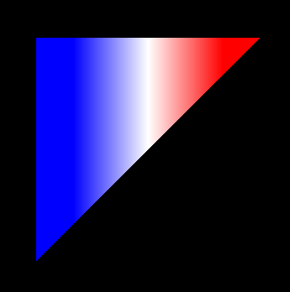
GL_TEXTURE_MAG_FILTER with NEAREST and LINEAR

Slide 35
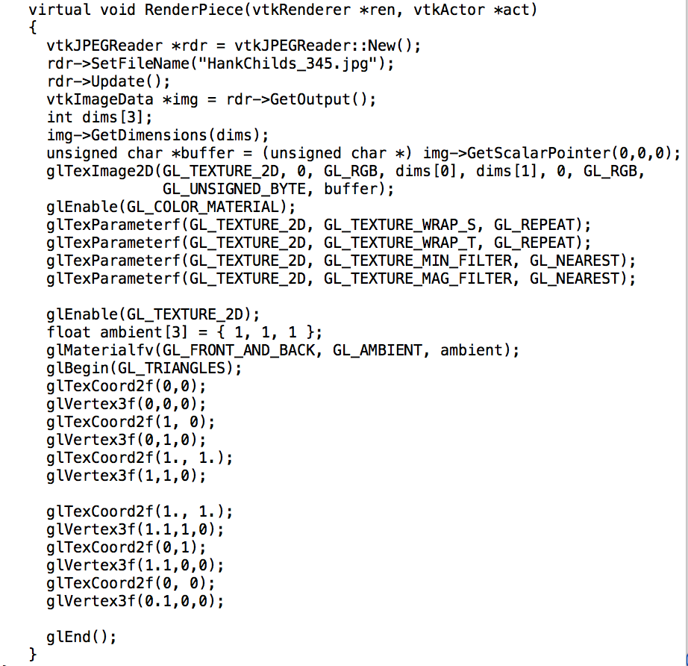
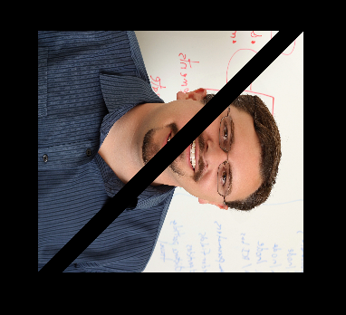
2D Texture Program
Texture is not 1:1, should probably scale geometry.
This is a terrible program … why?

Slide 36
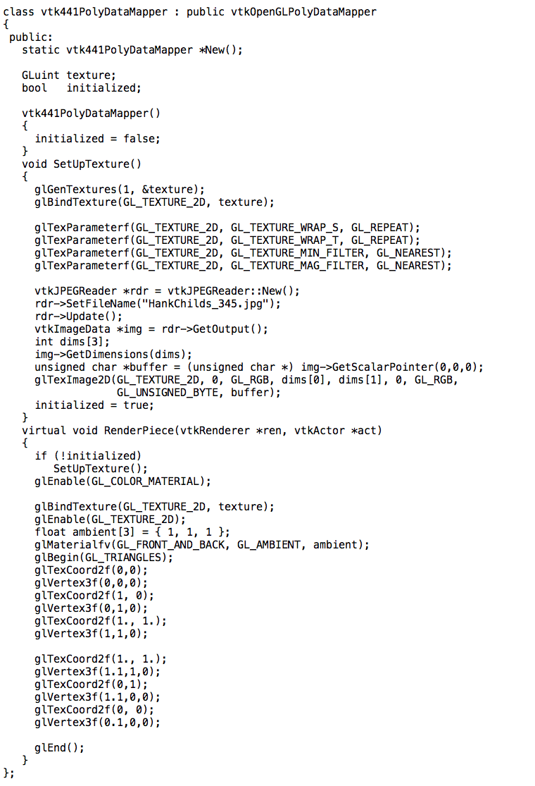
glBindTexture: tell the GPU about the texture once and re-use it!

Slide 37
More on Geometric Primitives

Slide 38
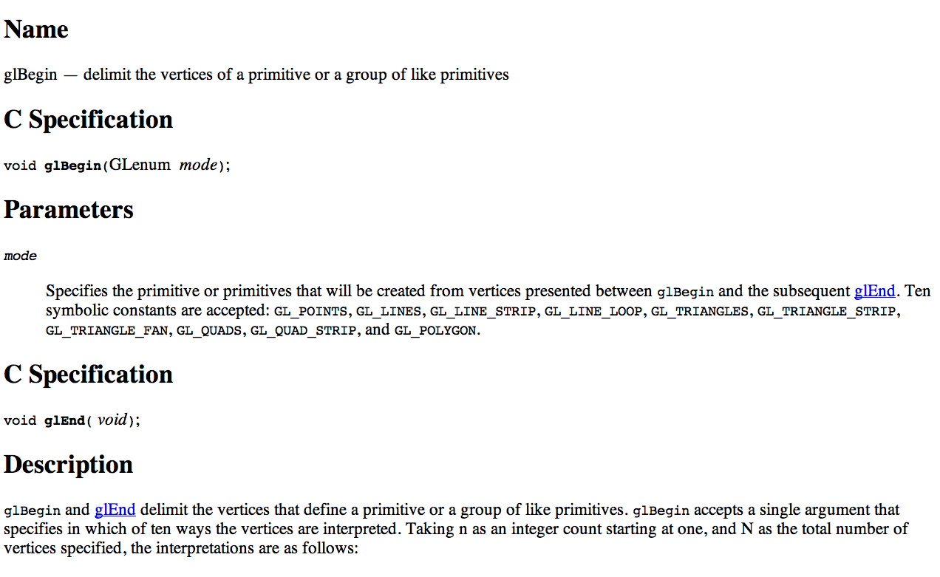
Geometric Specification: glBegin

Slide 39
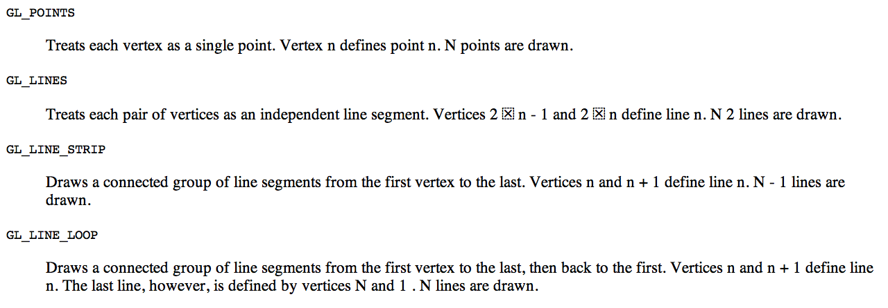
Geometric Primitives

Slide 40
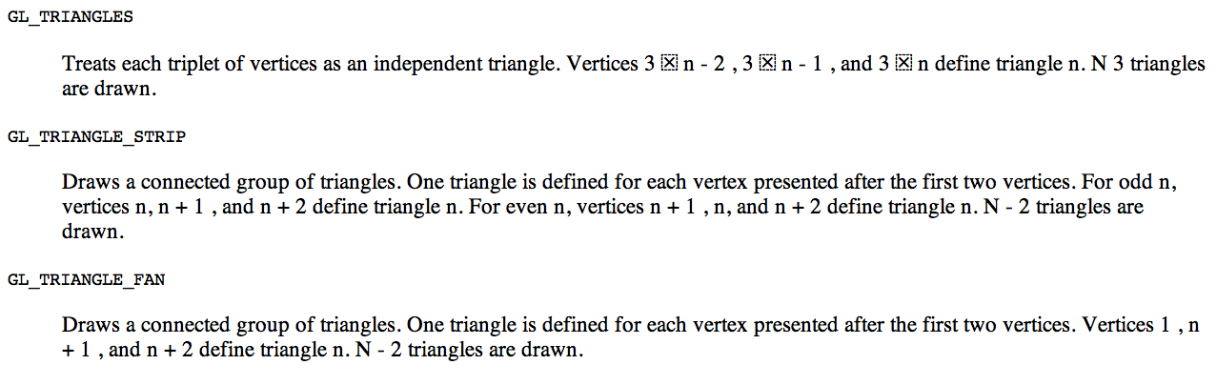
Geometric Primitives

Slide 41
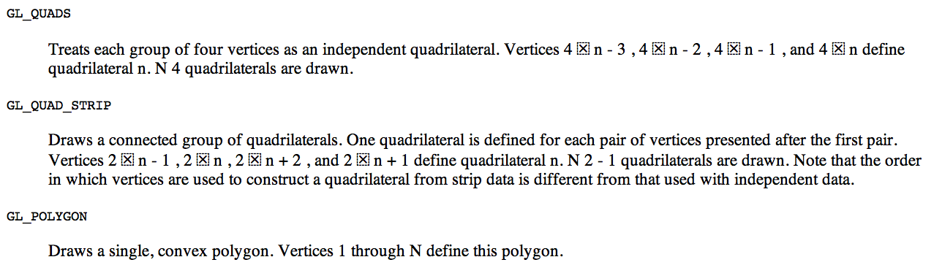
Geometric Primitives

Slide 42
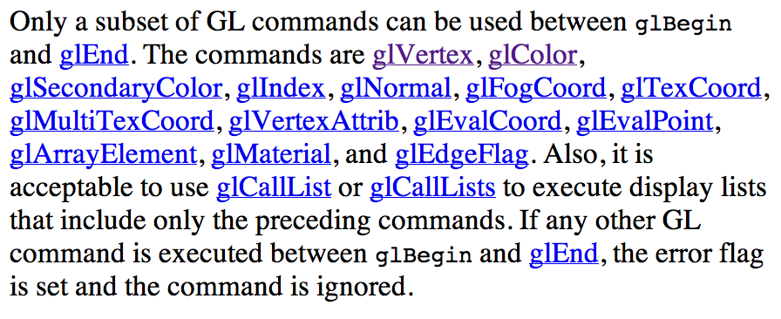
What can go inside a glBegin?

Slide 43
Lighting Model

Slide 44
Lighting
glEnable(GL_LIGHTING);
Tells OpenGL you want to have lighting.
Eight lights
Enable and disable individually
glEnable(GL_LIGHT0)
glDisable(GL_LIGHT7)
Set attributes individually
glLightfv(GL_LIGHTi, ARGUMENT, VALUES)

Slide 45
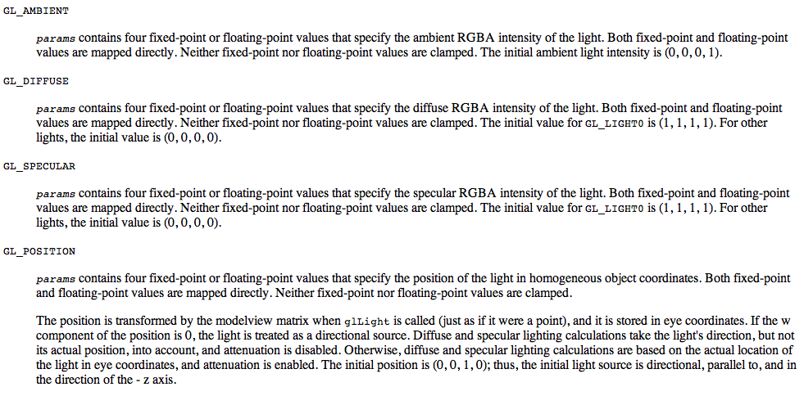
glLightfv parameters
Ten parameters (ones you will use):

Slide 46
glLightfv in action
For each light source, we can set an RGBA for the diffuse, specular, and ambient components:
glEnable(GL_LIGHTING);
glEnable(GL_LIGHT0);
Glfloat diffuse0[4] = { 0.7, 0.7, 0.7, 1 };
glLightfv(GL_LIGHT0, GL_DIFFUSE, diffuse0);
… // set ambient, specular, position
glDisable(GL_LIGHT1); // do we need to do this?
…
glDisable(GL_LIGHT7); // do we need to do this?

Slide 47
How do we tell OpenGL about the surface normals?
Flat shading:
glNormal3f(0, 0.707, -0.707);
glVertex3f(0, 0, 0);
glVertex3f(1, 1, 0);
glVertex3f(1, 0, 0);
Smooth shading:
glNormal3f(0, 0.707, -0.707);
glVertex3f(0, 0, 0);
glNormal3f(0, 0.707, +0.707);
glVertex3f(1, 1, 0);
glNormal3f(1, 0, 0);
glVertex3f(1, 0, 0);

Slide 48
Distance and Direction
The source colors are specified in RGBA
The position is given in homogeneous coordinates
If w =1.0, we are specifying a finite location
If w =0.0, we are specifying a parallel source with the given direction vector

Slide 49
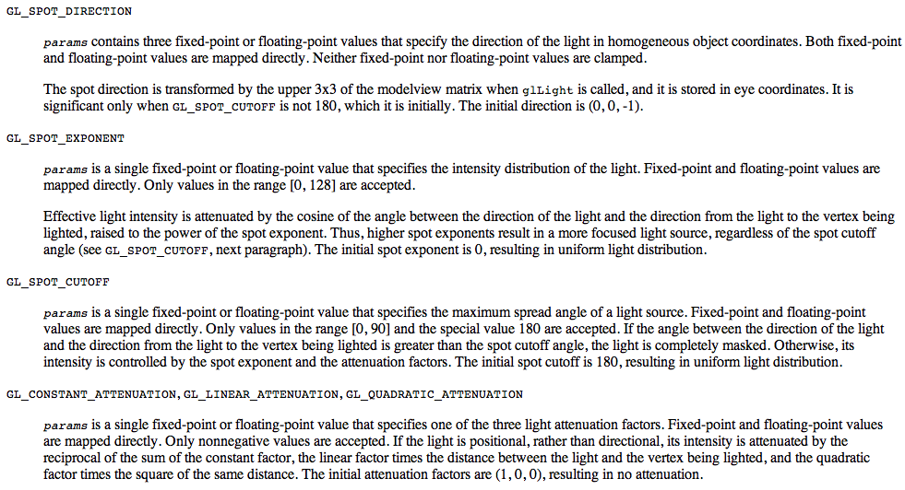
glLightfv parameters (2)
Ten parameters (ones you will never use)

Slide 50
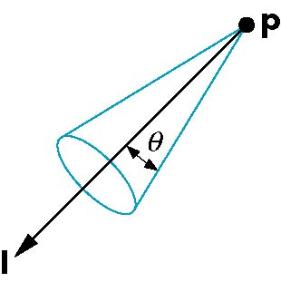
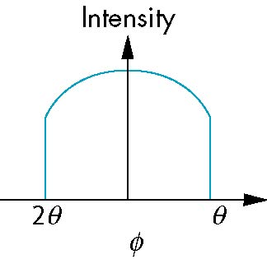
Spotlights
Use glLightv to set
Direction GL_SPOT_DIRECTION
Cutoff GL_SPOT_CUTOFF
Attenuation GL_SPOT_EXPONENT
Proportional to cos^{α}φ
−θ
φ
θ
50

Slide 51
What happens with multiple lights?
glEnable(GL_LIGHT0);
glEnable(GL_LIGHT1);
→ the effects of these lights are additive.
Individual shading factors are added and combined
Effect is to make objects brighter and brighter
Same as handling of high specular factors for 1E

Slide 52
Global Ambient Light
Ambient light depends on color of light sources
A red light in a white room will cause a red ambient term that disappears when the light is turned off
OpenGL also allows a global ambient term that is often helpful for testing
glLightModelfv(GL_LIGHT_MODEL_AMBIENT, global_ambient)
VTK turns this on by default!
Affects lighting of materials colored with glColor, but not glTexCoord1f!!

Slide 53
Shading Model

Slide 54
Polygonal Shading
Shading calculations are done for each vertex
Vertex colors become vertex shades
By default, vertex shades are interpolated across the polygon
glShadeModel(GL_SMOOTH);
If we use glShadeModel(GL_FLAT); the color at the first vertex will determine the shade of the whole polygon
We will come back to this in a few slides

Slide 55
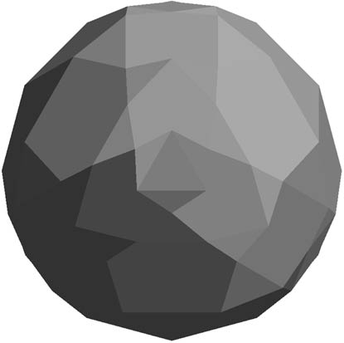
Polygon Normals
Polygons have a single normal
Shades at the vertices as computed by the Phong model can be almost same
Identical for a distant viewer (default) or if there is no specular component
Consider model of sphere
Different normals at
each vertex, want single normal

Slide 56
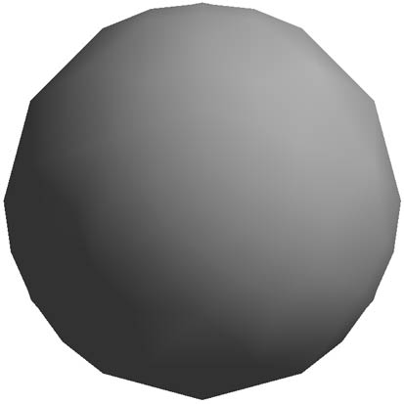
Smooth Shading
We can set a new normal at each vertex
Easy for sphere model
If centered at origin n = p
Now smooth shading works
Note silhouette edge

Slide 57
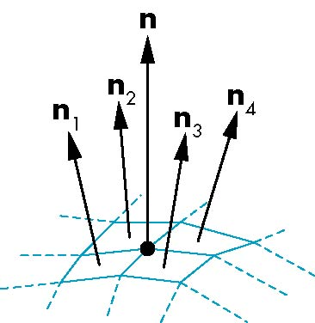
Mesh Shading
The previous example is not general because we knew the normal at each vertex analytically
For polygonal models, Gouraud proposed we use the average of the normals around a mesh vertex
n = (n₁+n₂+n₃+n₄)/ |n₁+n₂+n₃+n₄|

Slide 58
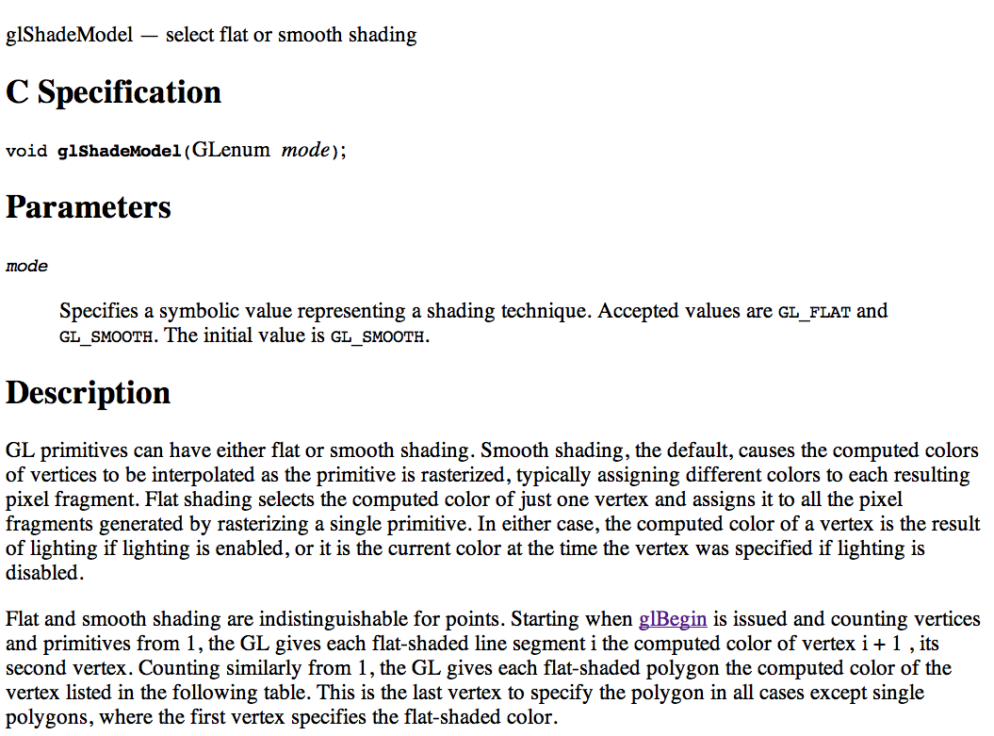
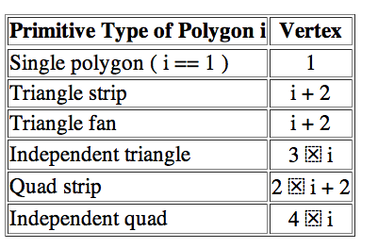
glShadeModel

Slide 59
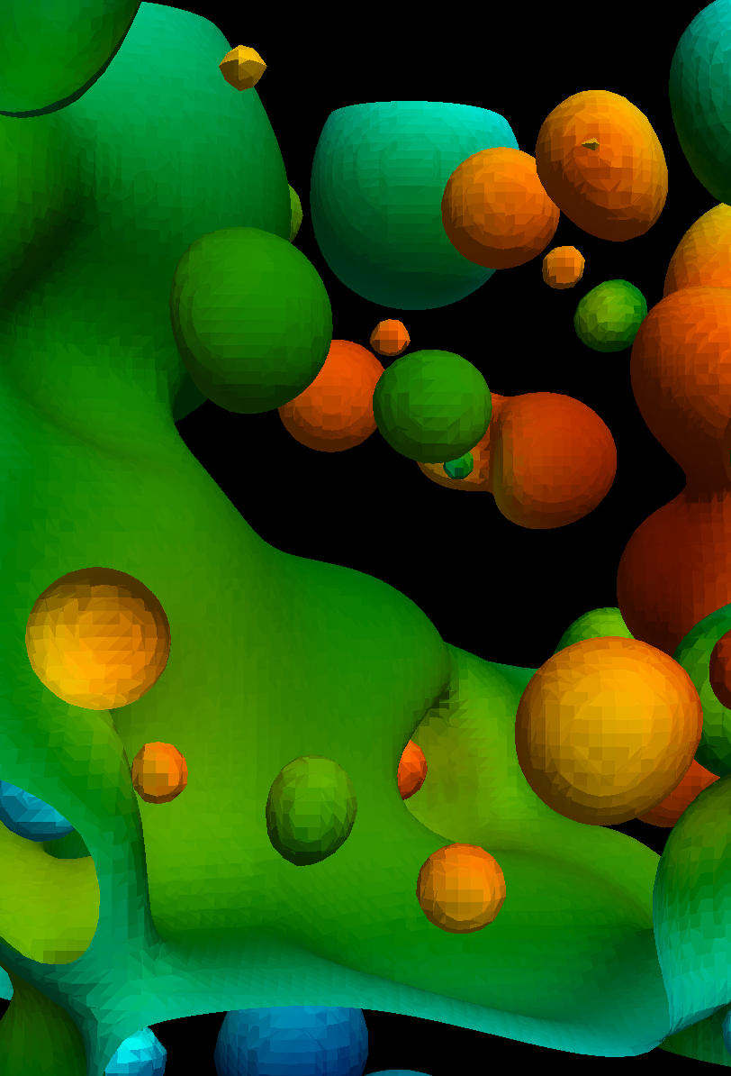

glShadeModel
glShadeModel
affects normals and colors

Slide 60
Material Model

Slide 61
glMaterial: coarser controls for color
You specify how much light is reflected for the material type.
Command:
glMaterialfv(FACE_TYPE, PARAMETER, VALUE(S))
FACE_TYPE =
GL_FRONT_AND_BACK
GL_FRONT
GL_BACK
(We will talk about this later)

Slide 62
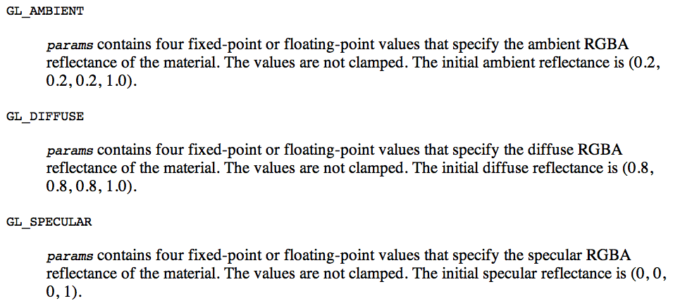
glMaterialfv Parameters

Slide 63
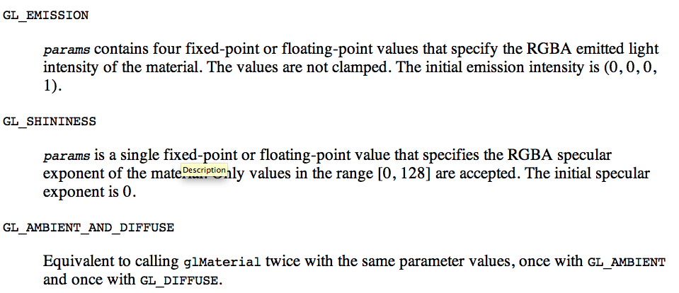
glMaterialfv Parameters

Slide 64
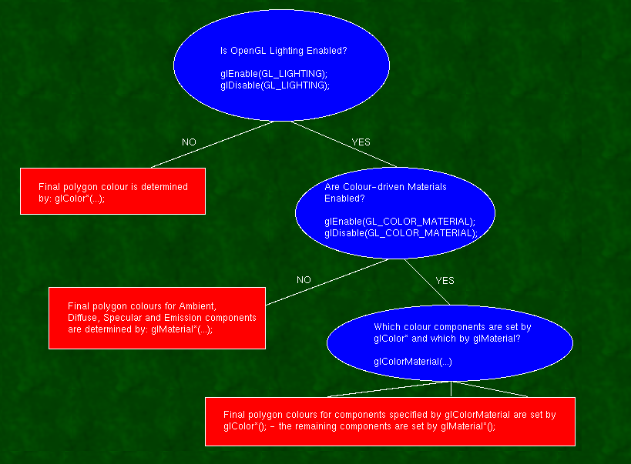
OpenGL: very complex model for lighting and colors
glMaterial not used
glColor
is no-op
http://www.sjbaker.org/steve/omniv/opengl_lighting.html

Slide 65
Basic OpenGL light model
The OpenGL light model presumes that the light that reaches your eye from the polygon surface arrives by four different mechanisms:
AMBIENT
DIFFUSE
SPECULAR
EMISSION - in this case, the light is actually emitted by the polygon - equally in all directions.
http://www.sjbaker.org/steve/omniv/opengl_lighting.html

Slide 66
Difference between lights and materials
There are three light colours for each light:
Ambient, Diffuse and Specular (set with glLight)
There are four colors for each surface
Same three + Emission(set with glMaterial).
All OpenGL implementations support at least eight light sources - and the glMaterial can be changed at will for each polygon
http://www.sjbaker.org/steve/omniv/opengl_lighting.html

Slide 67
Interactions between lights and materials
The final polygon colour is the sum of all four light components, each of which is formed by multiplying the glMaterial colour by the glLight colour (modified by the directionality in the case of Diffuse and Specular).
Since there is no Emission colour for the glLight, that is added to the final colour without modification.
http://www.sjbaker.org/steve/omniv/opengl_lighting.html

Slide 68
Display Lists

Slide 69
CPU and GPU
Most common configuration has CPU and GPU on separate dies
I.e., plug GPU in CPU
CPU
(typically 4-12 cores, ~10GFLOPs)
GPU
(typically 100-1000 cores, ~100GFLOPs-~1000GFLOPs)
PCIe
Peripheral Component Interconnect Express
What are the performance ramifications of this architecture?

Slide 70
Display lists
Idea:
send geometry and settings to GPU once, give it an identifier
GPU stores geometry and settings
Just pass the identifier for every subsequent render

Slide 71
Display lists
Generate an idenfitier:
GLUint displayList = glGenLists(1);
Tell GPU that all subsequent geometry is part of the list:
glNewList(displayList,GL_COMPILE);
Specify geometry (i.e., glVertex, etc)
Tell GPU we are done specifying geometry:
glEndList();
Later on, tell GPU to render all the geometry and settings associated with our list:
glCallList(displayList);

Slide 72
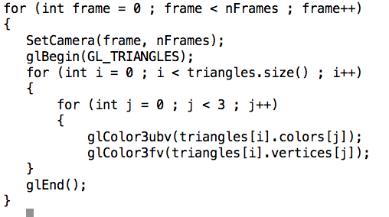

Display lists in action
What are the performance ramifications between the two?

Slide 73
glNewList
GL_COMPILE
Make the display list for later use.
GL_COMPILE_AND_EXECUTE
Make the display list and also execute it as you go.

